Slide 1

SUSTAINABLE
DEVELOPMENT
GOALS
- An SQL Research Project Presented By Anushka Banerjee
Top Ranked Data Science & Analytics Education Provider since 2007

Slide 2

The Sustainable Development Goals were adopted by the United Nations in 2015
Top Ranked Data Science & Analytics Education Provider since 2007

Slide 3

Top Ranked Data Science & Analytics Education Provider since 2007

Slide 4

Table of Content
Insights
Discussion
Methodology
Objective
Dataset Review
Top Ranked Data Science & Analytics Education Provider since 2007

Slide 5
Dataset Review
The dataset under review is sourced from Kaggle and focuses on valuable insights into global sustainability efforts and countries' progress in achieving sustainable development.
The dataset comprising 86,961 SDG records spanning from 2000 to 2022, a subset of 15,204 entries was meticulously extracted and partitioned into five distinct tables, each representing a specific year from 2018 to 2022.
It encompasses a mix of numerical and categorical variables, capturing diverse dimensions of goals.
The dataset appears relatively clean, with no missing values.
Top Ranked Data Science & Analytics Education Provider since 2007

Slide 6

Objective
Assessment of Overall SDG Index: Evaluate the overall SDG Index score for each country and identify countries performing well and those lagging.
2. Assessment of COVID-19 Impacts: Evaluate the direct and indirect impacts of the COVID-19 pandemic on each of the SDGs, considering disruptions to healthcare systems, economic downturns, disruptions in education, setbacks in poverty reduction efforts, and exacerbation of inequalities.
Regional Comparisons: Compare the performance of countries within regions (developed vrs developing) to understand regional trends and disparities.
Policy Implications: Discuss the policy implications of the findings, highlighting successful strategies and areas requiring targeted interventions.
Top Ranked Data Science & Analytics Education Provider since 2007

Slide 7
Methodology
Utilization of SQL techniques in my project methodology
Data Retrieval and Integration: Leveraging INNER JOIN, JOIN, and UNION
Data Organization: Common Table Expressions (CTEs) were utilized.
View Creation : SQL views were created to encapsulate frequently used queries.
Aggregation and Calculation: Functions such as AVG, SUM, GROUP BY, MIN, and MAX were employed.
Data Filtering and Sorting: The WHERE clause was utilized to filter data based on specific criteria.
Additionally, DESC and LIMIT were used in conjunction with ORDER BY to sort and limit result sets.
Comprehensive Analysis: The methodology facilitated in-depth analysis of SDG-related data.
Top Ranked Data Science & Analytics Education Provider since 2007

Slide 8
Discussion
Average SDG index score across all countries for each year
The average SDG (Sustainable Development Goals) index score, which serves as a reflection of the collective progress made by countries towards achieving the goals, demonstrates a consistent and upward trajectory over the years.
Top Ranked Data Science & Analytics Education Provider since 2007

Slide 9
Average score for each SDG goal across all years
Goals 12 (Responsible Consumption and Production) and 13 (Climate Action) have the highest average scores, indicating relatively better progress in these areas.
Goal 9 (Industry, Innovation, and Infrastructure) has the lowest average score, suggesting challenges in this domain.
Top Ranked Data Science & Analytics Education Provider since 2007

Slide 10
Country that consistently performed the best and worst across all SDG goals from 2018 to 2022
GOALS | 2018 | 2019 | 2020 | 2021 | 2022
Goal 1 | 100 | 100 | 100 | 100 | 100
Goal 2 | 61 | 64 | 62 | 61 | 61
Goal 3 | 95 | 96 | 96 | 95 | 95
Goal 4 | 98 | 98 | 97 | 97 | 97
Goal 5 | 89 | 92 | 91 | 91 | 92
Goal 6 | 94 | 94 | 94 | 94 | 94
Goal 7 | 92 | 93 | 93 | 93 | 93
Goal 8 | 87 | 87 | 87 | 87 | 87
Goal 9 | 95 | 95 | 96 | 96 | 96
Goal 10 | 98 | 97 | 99 | 99 | 99
Goal 11 | 91 | 89 | 91 | 92 | 91
Goal 12 | 91 | 89 | 91 | 92 | 91
Goal 13 | 66 | 67 | 69 | 69 | 69
Goal 14 | 85 | 88 | 88 | 88 | 88
Goal 15 | 85 | 85 | 85 | 85 | 85
Goal 16 | 91 | 92 | 93 | 92 | 93
Goal 17 | 69 | 70 | 71 | 73 | 76
GOALS | 2018 | 2019 | 2020 | 2021 | 2022
Goal 1 | 0 | 0 | 0 | 0 | 0
Goal 2 | 19 | 19 | 20 | 20 | 20
Goal 3 | 24 | 24 | 24 | 24 | 24
Goal 4 | 1 | 1 | 1 | 1 | 1
Goal 5 | 54 | 54 | 54 | 56 | 56
Goal 6 | 41 | 41 | 41 | 41 | 41
Goal 7 | 12 | 11 | 11 | 11 | 11
Goal 8 | 51 | 51 | 50 | 50 | 51
Goal 9 | 1 | 1 | 1 | 2 | 2
Goal 10 | 27 | 27 | 27 | 27 | 27
Goal 11 | 14 | 14 | 14 | 14 | 14
Goal 12 | 91 | 91 | 91 | 91 | 91
Goal 13 | 99 | 99 | 99 | 99 | 99
Goal 14 | 0 | 0 | 0 | 0 | 0
Goal 15 | 75 | 75 | 75 | 75 | 75
Goal 16 | 39 | 39 | 40 | 39 | 38
Goal 17 | 38 | 41 | 40 | 43 | 42
Top Ranked Data Science & Analytics Education Provider since 2007
Finland
South Sudan

Slide 11
Assessment of COVID-19 Impacts
Average SDG index score change from pre-COVID (2018-2019) to post-COVID (2020-2022) across all countries
Modest Improvement of 0.6565 in overall SDG score following the onset of Pandemic
Top Ranked Data Science & Analytics Education Provider since 2007

Slide 12
Country experienced the most significant decrease in SDG index score from pre-COVID to post-COVID?
POST COVID
Goals | 2018 | 2019 | 2020 | 2021 | 2022
Goal 1 | 77 | 77 | 78 | 54 | 58
Goal 2 | 66 | 66 | 66 | 66 | 66
Goal 3 | 54 | 55 | 56 | 50 | 50
Goal 4 | 56 | 61 | 61 | 61 | 61
Goal 5 | 57 | 56 | 58 | 58 | 58
Goal 6 | 67 | 68 | 69 | 69 | 69
Goal 7 | 44 | 43 | 45 | 45 | 45
Goal 8 | 64 | 62 | 62 | 66 | 66
Goal 9 | 27 | 28 | 30 | 30 | 30
Goal 10 | 87 | 87 | 87 | 87 | 87
Goal 11 | 63 | 63 | 64 | 54 | 55
Goal 12 | 95 | 95 | 95 | 94 | 94
Goal 13 | 98 | 98 | 98 | 98 | 98
Goal 14 | 50 | 48 | 48 | 48 | 48
Goal 15 | 52 | 52 | 52 | 52 | 52
Goal 16 | 59 | 58 | 58 | 47 | 42
Goal 17 | 42 | 47 | 48 | 49 | 50
The query output indicates that Myanmar experienced the largest decrease in the
average SDG index score between the
pre-COVID and post-COVID periods, with a decrease of 3.0000.
This suggests a significant negative impact on sustainability efforts in Myanmar following the onset of the COVID-19 pandemic.
Top Ranked Data Science & Analytics Education Provider since 2007
Year-wise table of Myanmar

Slide 13
Decrease in their Goal 1 (No Poverty) score from 2019 to 2022
Myanmar experienced the largest decrease in Goal 1 score, with a decline of 19 points.
Afghanistan followed with a decrease of 17 points.
Several countries, including Venezuela, Colombia, Haiti, Yemen, Ecuador, Morocco, Sri Lanka, Chile, Sudan, and others, had moderate decreases ranging from 3 to 8 points.
Some countries, such as Angola, Belize, Bolivia, Chad, Fiji, Gabon, Jamaica, Mexico, Namibia, Somalia, and others, had smaller decreases of 1 or 2 points.
A few countries, like Central African Republic, Costa Rica, Ghana, Oceania, Small Island Developing States, showed either stable scores or minor improvements.
Top Ranked Data Science & Analytics Education Provider since 2007

Slide 14
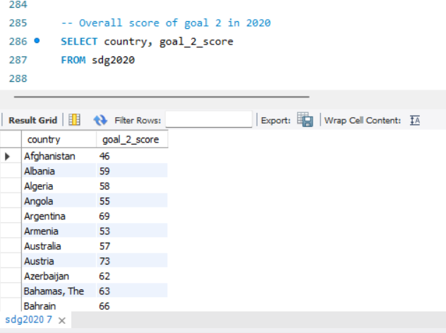
Overall score of goal 2(Zero Hunger) in 2020
1. Afghanistan: Scored 46, indicating moderate progress towards achieving zero hunger.
2. China: Scored 83, showcasing significant advancement in ensuring food security and adequate nutrition.
3. Democratic Republic of the Congo: Scored 52, suggesting ongoing efforts are needed to combat hunger and malnutrition.
4. Haiti: Scored 51, indicating persistent challenges in achieving food security and reducing hunger.
5. India: Scored 54, reflecting the need for sustained efforts to address food insecurity and improve nutrition.
6. United States: Scored 69, indicating relatively strong progress towards achieving zero hunger.
Top Ranked Data Science & Analytics Education Provider since 2007

Slide 15
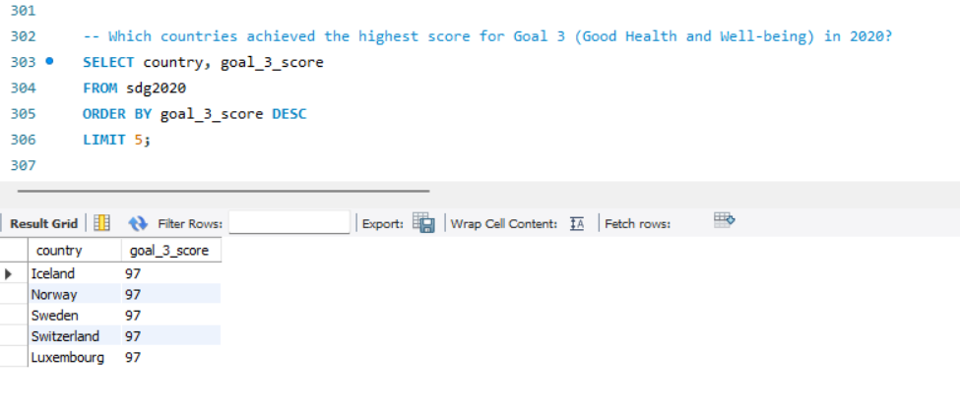
Overall score of goal 3(Good Health and Well-being) in 2020
Bhutan demonstrated the most significant improvement in Goal 3 (Good Health and Well-being) from 2018 to 2022, with a score increase of 5 points.
Switzerland, Sweden, Norway, Luxembourg, and Iceland all achieved the highest score of 97 for Goal 3 (Good Health and Well-being) in 2020. This remarkable accomplishment reflects the robust healthcare systems and comprehensive well-being initiatives implemented in these countries.
Top Ranked Data Science & Analytics Education Provider since 2007

Slide 16
Overall score for Goal 13 (Climate Action) across all countries in 2020
During the pandemic, there were temporary reductions in industrial activities, transportation, and energy consumption in many parts of the world. This led to short-term reductions in greenhouse gas emissions and air pollutants in certain regions.
Countries like Burundi, Central African Republic, and Somalia have achieved the highest score of 100, indicating strong efforts or achievements in climate action.
On the other hand, some countries like Brunei Darussalam, Qatar, and United Arab Emirates have relatively low scores, suggesting that there might be challenges or less progress in addressing climate-related issues in these countries.
Top Ranked Data Science & Analytics Education Provider since 2007

Slide 17
Regional Comparison
Percentage change in the average SDG scores for developing and developed country.
Developing countries generally had slightly higher percentage changes compared to developed countries, suggesting that they may have experienced relatively faster improvement in achieving sustainable development goals during this period.
Top Ranked Data Science & Analytics Education Provider since 2007

Slide 18
Insights and Policies
Here are some possible policies and insights related to the SDGs:
1. Education (SDG 4) : Free education for all, focusing on marginalized.
2. Gender Equality (SDG 5) : Equal rights for women everywhere.
3. Clean Water (SDG 6) : Safe water for all.
4. Clean Energy (SDG 7) : Renewable power promotion.
5. Sustainable Cities (SDG 11) : Eco-friendly urban planning.
6. Climate Action (SDG 13) : Emission cuts, resilient infrastructure.
7. Partnerships (SDG 17) : Global cooperation for goals.
Top Ranked Data Science & Analytics Education Provider since 2007

Slide 19
Thank you
Top Ranked Data Science & Analytics Education Provider since 2007

